Slide 1
Capstone Project-01
EDA on Airbnb Booking Analysis

Slide 2
Problem Statement
A dataset is provided,with the basic information of an availability around 365 days.
We must examine and evaluate the data in the given dataset in order to identify the important characteristics that influence the Airbnb bookings.
So,What factors influence an Airbnb’s bookings?
A high number of reviews.
An affordable price.
A high number of availability around 365 days.
A good number of reviews per month.

Slide 3
Data Summary
Airbnb NYC 2019
id
name
host_id
host_name
neighbourhood_group
neighbourhood
latitude
longitude
room_type
price
minimum_nights
number_of_reviews
last_review
reviews_per_month
calculated_host_listings_count
availability_365

Slide 4
AGENDA
Uploaded the dataset.
Used different functions to clean up the data.
Data Visualization
Finding the how much percent the room type as been used by using Piechart.
Finding the price distribution for price and number if listings by using histogram.
Finding the top 10 neighbourhoods by using the barplot.
Finding the availabilty in 365 days by using histplot.
Challenges Faced
Conclusion
Thankyou

Slide 5
Uploaded dataset
Import libraries such as numpy,pandas,matplotlib and seaborn.
Upload the dataset which is in csv which is provided and read the file by using pd.read_csv(‘path’)
Run the program.

Slide 6
Used different functions to clean up the data
head()
tail()
isnull()
Isnull().sum()
unique()
any()
shape
info()
describe()
duplicated().sum()
Columns
fillna
dtype
Still some functions are used.

Slide 7
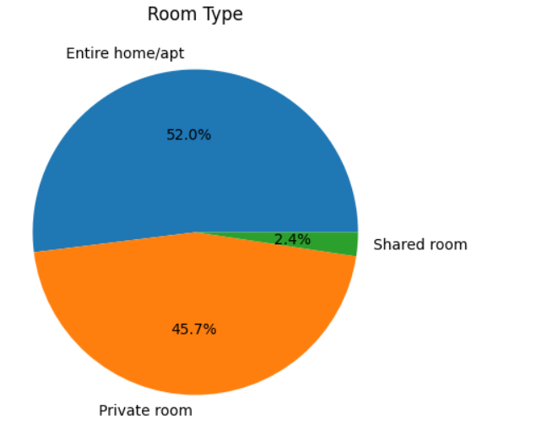
Data Visualization
To represent the data in the form of graphical representation such as piechart,histogram,barplot etc.
Finding the how much percent the room type as been used by using Piechart.

Slide 8
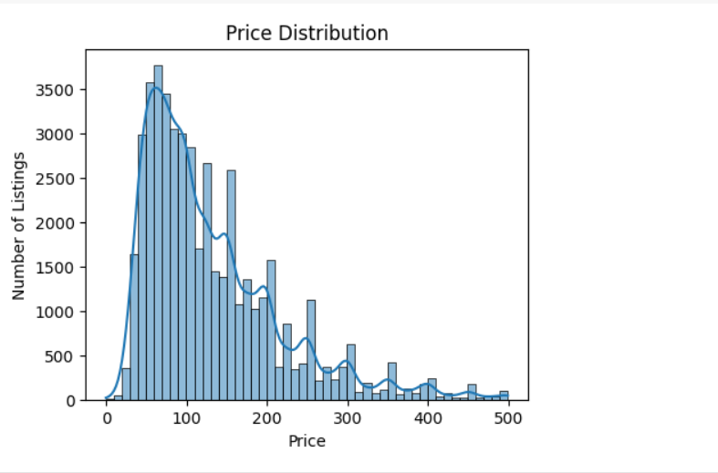
Finding the price distribution for price and number if listings by using histogram.

Slide 9
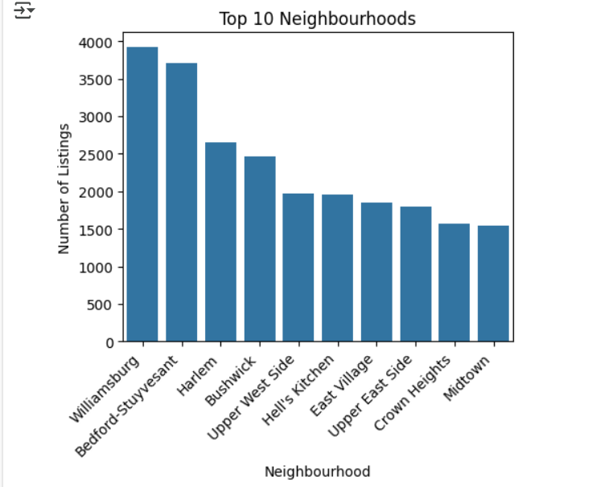
Finding the top 10 neighbourhoods by using the barplot.

Slide 10
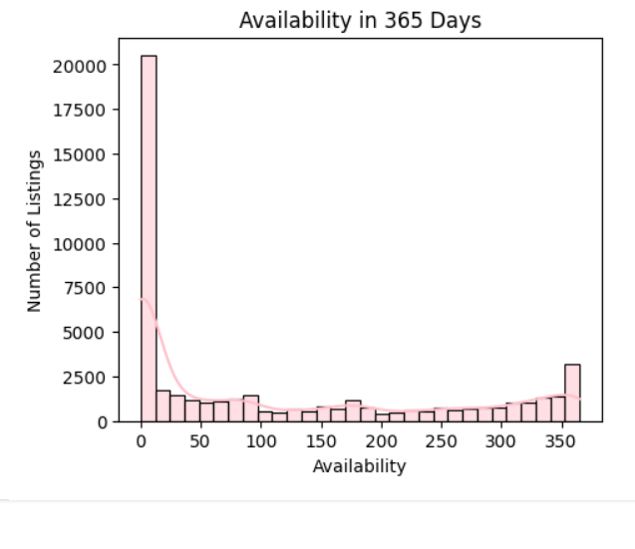
Finding the availabilty in 365 days by using histplot.

Slide 11
Challenges Faced
Uploading the dataset.
Finding the missing values and filling the values.
Data Visualization.

Slide 12
Conclusion
I conclude that I completed the project presentation by using various functions to clean up the data and I used various data visualization to represent the data.

Slide 13


